Slide 1






FENERBAHCE-CPU
PROJECT
Presented by: Eslam Akkad
Osama Alchati , Omar Badubais , Hasibullah Rasuly

Slide 2
INTRODUCTION
CPU
Block Ram Module
Fbu-Cpu Module
Testbench
Testbench Module
Project Scope
01
02
03
04
05
06

Slide 3


CPU
Definition
The central processing unit (CPU) stands as the cornerstone of a computer, assuming the pivotal responsibility of executing the instructions encapsulated within computer programs. Serving as the computational powerhouse, the CPU interprets and performs a series of commands, thereby orchestrating the seamless execution of a diverse array of tasks.
Function
The CPU performs arithmetic and logic operations, manages data storage and retrieval, and controls input and output operations. It interprets and executes instructions from computer programs.

Slide 4


CPU
Architecture
CPUs can have different architectures, such as CISC (Complex Instruction Set Computing) or RISC (Reduced Instruction Set Computing). These architectures determine how the CPU processes instructions.
Clock Speed
The clock speed, measured in Hertz (Hz) or Gigahertz (GHz), indicates how quickly the CPU can execute instructions. Higher clock speeds generally result in faster performance.

Slide 5
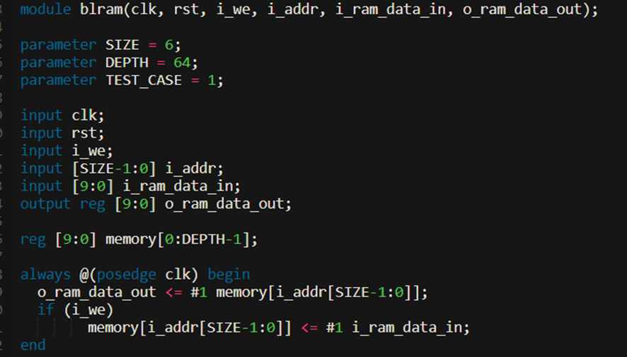



BLOCK RAM MODULE
The blram module is a simple block RAM module with read and write capabilities.
01
It includes parameters for SIZE (address width), DEPTH (depth of the memory), and TEST_CASE.
02
It has input and output ports for clock (clk), reset (rst), write enable (i_we), address (i_addr), input data (i_ram_data_in), and output data (o_ram_data_out).
03

Slide 6
BLOCK RAM MODULE
The module contains a memory array (memory) to store data.
04
The always block is triggered on the positive edge of the clock. It performs read and write operations based on the inputs.
05
The initial block initializes the memory based on the chosen TEST_CASE
06

Slide 7
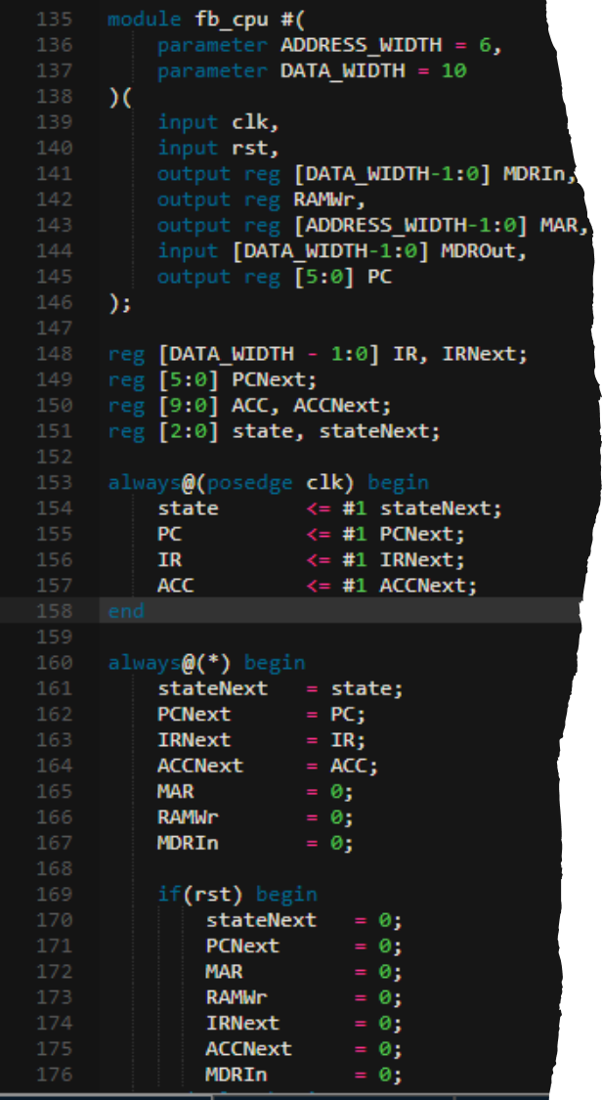

FBU-CPU MODULE
The fb_cpu module represents a simple microprocessor with an instruction set.
01
02
It includes parameters for ADDRESS_WIDTH and DATA_WIDTH.
03
The module contains internal registers (IR, PC, ACC) and a state machine (state).
The module has input and output ports for clock (clk), reset (rst), memory data in (MDRIn), RAM write enable (RAMWr), memory address (MAR), memory data out (MDROut), and program counter (PC).
04

Slide 8
FBU-CPU MODULE
The always block is triggered on the positive edge of the clock and updates internal registers based on the next-state values.
05
The combinational block determines the next-state logic based on the current state and performs default assignments. It also handles the reset condition.
06

Slide 9



TESTBENCH
the testbench initializes the system, selects a test case, checks the memory content after execution, and terminates the simulation. The specific behavior of the testbench depends on the chosen test case and the functionality of the microprocessor and memory modules.

Slide 10
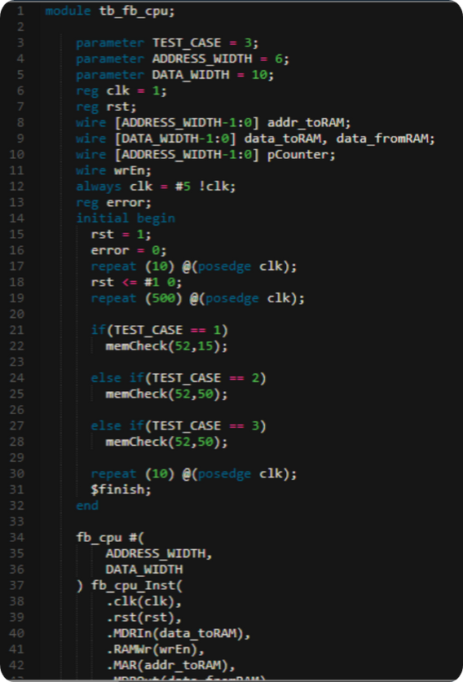
TESTBENCH MODULE
The TB_FB_CPU module is the testbench for the microprocessor.
The module has input and output ports for clock (clk), reset (rst), memory address to RAM (addr_toRAM), memory
01
03
It includes parameters for TEST_CASE, ADDRESS_WIDTH, and DATA_WIDTH.
02

Slide 11


PROJECT SCOPE

Slide 12
PROJECT SCOPE
The design consists of a simple CPU (fb_cpu) and memory module (blram). The testbench (tb_fb_cpu) verifies the functionality of these modules by executing different test cases. The top-level module (top) instantiates the testbench module.

Slide 13






Our Team
Osama Alchati
Omar Badubais
Eslam Akkad
Hasibullah Rasuly
osama.alchati@stu.fbu.edu.tr
omar.badubais@stu.fbu.edu.tr
eslam.mahmoud@stu.fbu.edu.tr
hasibullah.rasuly@stu.fbu.edu.tr

Slide 14

THANK YOU!

